Slide 1
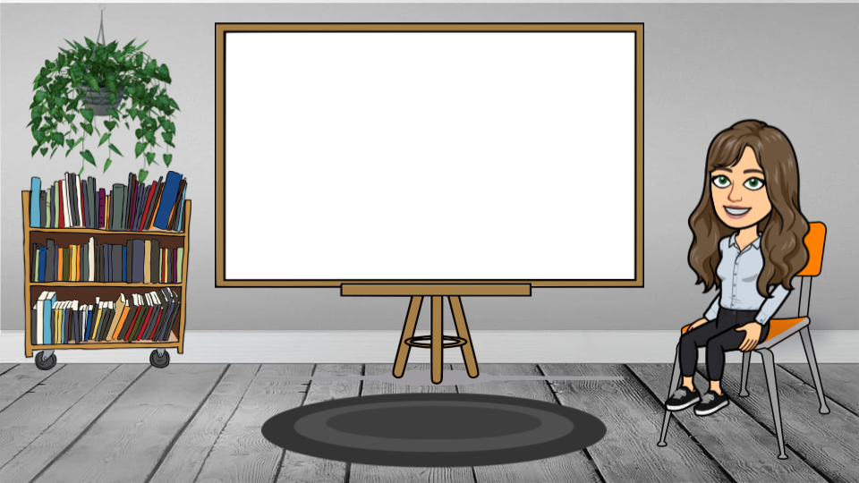
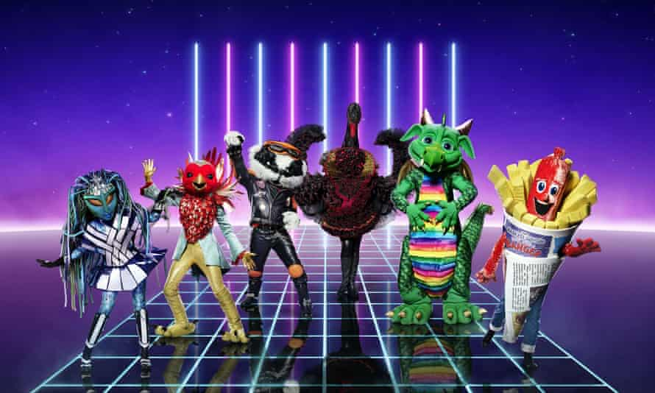

Slide 2
How to enter
Each Masked Reader is reading the blurb of their favourite childhood book.
Your job is to guess the ‘Author’ and ‘Title’ of the book being read.
You will get a bonus point for each member of staff you successfully unveil.
All entries should be returned to your class teacher by Thursday 13th March.
World Book Day
2025
#TheMaskedReader

Slide 3
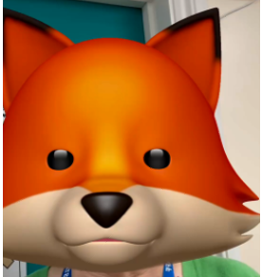
Number 1
The
Fox

Slide 4
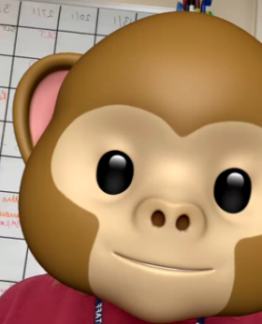
Number 2
The Monkey

Slide 5
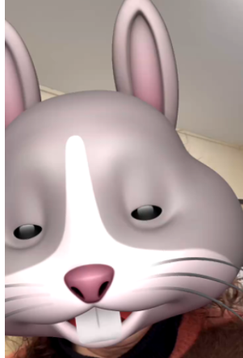
Number 3
The
Rabbit

Slide 6
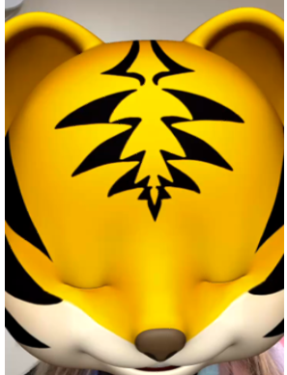
Number 4
The Tiger

Slide 7
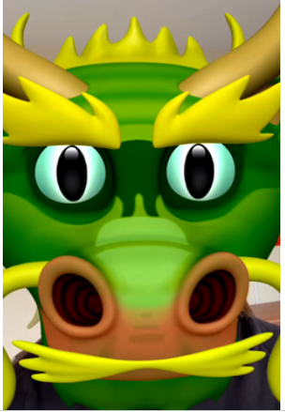
Number 5
The Dragon

Slide 8
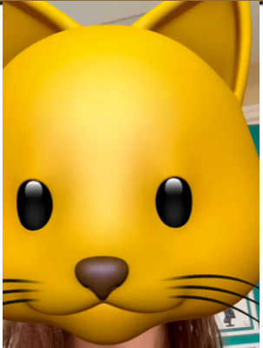
Number 6
The
Cat

Slide 9
Masked Reader | Title | Author | Member of Staff
Answer Sheet

Slide 10
How to enter
Each Masked Reader is reading the blurb of their favourite childhood book.
Your job is to guess the ‘Author’ and ‘Title’ of the book being read.
You will also get a bonus point for each member of staff you successfully unveil.
All entries should be returned to your class teacher.
World Book Day
2025
#TheMaskedReader
Closing Date: Thursday 13th March

